Slide 1
Introduction
*A programming language and computing platform released by Sun Microsystems in 1995, currently owned by Oracle.
*Desktop GUI apps, Mobile apps, Embedded systems, Web applications, web servers , application servers, Enterprise applications.
*One of the most highly used and highly paid languages of the world.

Slide 2
Why Java
*Easy to learn
*Multithreaded
*Distributed Applications
*Secure
*Robust

Slide 3
Why Java: Platform Independent
Platform Dependent
myprog.exe
myprog.c
machine code
C source code
gcc
OS/Hardware
Platform Independent
javac
myprog.class
myprog.java
bytecode
Java source code
JVM
OS/Hardware

Slide 4
Primitive types
int 4 bytes
short 2 bytes
long 8 bytes
byte 1 byte
float 4 bytes
double 8 bytes
char Unicode encoding (2 bytes)
boolean {true, false}
Behaviors is exactly as in C++
Note:
Primitive type
always begin
with lower-case

Slide 5
Primitive types - cont.
Constants
37 integer
37.2 double
37.2F float
0754 integer (octal)
0xfe integer (hexadecimal)

Slide 6
Type Conversion(implicit) and Casting(explicit)
* When one type of data is to be stored in other type of variable , and this conversion takes automatically then it is type conversion. It is done automatically by compiler.
* If the conversion is not automatic, then it needs to be done explicitly. This will be called explicit casting.
syntax : target_type var=(target_type)source_var;

Slide 7
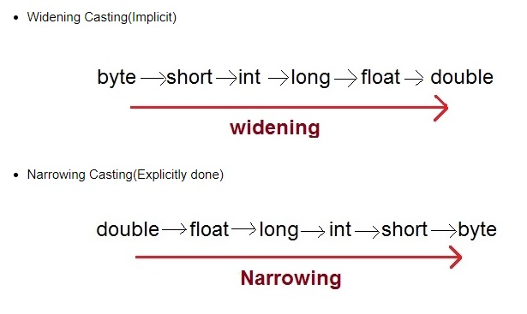
Type Conversion(implicit) and Casting(explicit)

Slide 8
Sample Program
Hello.java
class Hello {
public static void main(String[] args) {
System.out.println(“Hello World !!!”); }
}
C:\javac Hello.java
C:\java Hello
( compilation creates Hello.class )
(Execution on the local JVM)

Slide 9
Wrappers
*Java keeps using primitives for performance reasons. But primitives do not have methods which objects do have.
* Wrapper classes are used to convert any data type into an object, so that methods are also available on them.
Example:
Coding example
Integer n = new Integer(“4”);
int m = n.intValue();
Read more about Integer in JDK Documentation

Slide 10
Wrappers
int ------> Integer
float -----> Float
double ----->Double
char ----->Character
boolean --->Boolean
short ------->Short
long ------>Long
byte------->Byte

Slide 11
Number Class: Parent of All wrapper classes
All the methods of Number class are present in the wrapper classes too due to inheritance(to be studied later)
Sample code.

Slide 12
Character Class
Character Methods
isLetter() Determines whether the specified char value is a letter.
isDigit()Determines whether the specified char value is a digit.
isWhitespace()Determines whether the specified char value is white space.
isUpperCase()Determines whether the specified char value is uppercase.
isLowerCase()Determines whether the specified char value is lowercase.
toUpperCase()Returns the uppercase form of the specified char value.
toLowerCase()Returns the lowercase form of the specified char value.
toString()Returns a String object representing the specified character value that is, a one-character string.

Slide 13
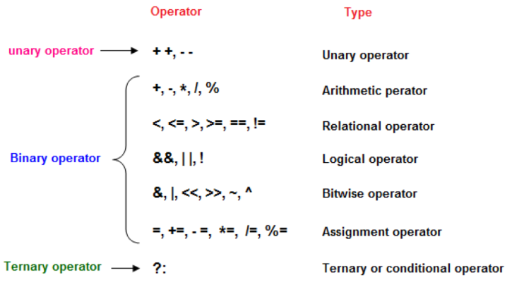
Operators

Slide 14
Conditional Execution
If
if – else
if-else if ladder
nested if
switch_case :
(String also supported after java 7)

Slide 15
Loops
while loop
for loop
do_while loop
For each loop(with array)
Nested loops

Slide 16
Loops
while loop
for loop
do_while loop
Nested loops

Slide 17
Different Programming Paradigms
*Functional/procedural programming:
program is a list of instructions to the computer
*Object-oriented programming
program is composed of a collection objects that communicate with each other
Notes:
flexibility, easing changes to programs
easier to learn
simpler to develop, maintain and analysize

Slide 18
Main Concepts
*Object
*Class
*Inheritance
*Encapsulation

Slide 19
Objects
identity – unique identification of an object
attributes – data/state
services – methods/operations
supported by the object
within objects responsibility to provide these services to other clients

Slide 20
Class
“type”
object is an instance of class
class groups similar objects
same (structure of) attributes
same services
object holds values of its class’s attributes

Slide 21
Packages
Collection of similar type of classes
importing package.
How to create package.
Package naming convention

Slide 22
Encapsulation
Encapsulation in Java is a mechanism of wrapping the data (variables) and methods acting on the data (methods) together as a single unit. In encapsulation, the variables of a class will be hidden from other classes, and can be accessed only through the methods of their current class.
Also known as data hiding.
To achieve encapsulation in Java −
Declare the variables of a class as private.
Provide public setter and getter methods to modify and view the variables values.

Slide 23
Benefits?
Modularity
source code for an object can be written and maintained independently of the source code for other objects
easier maintenance and reuse
Information hiding
other objects can ignore implementation details
security (object has control over its internal state)

Slide 24
Types of variables
Local : block level, lifecycle : block execution
Function arguments
Static : Class level define.
Instance : Class level define.

Slide 25
Types of methods
static : can be used directly on class name, without creating objects( No need to maintain state)
Instance : can be used only on object because they modify the state of object

Slide 26
Constructor
Special type of method in class, used to initialize its data members with default values
Types : 3 types
Default : Default/Same initial values for all objects
Parameterized : Custom values
Copy Constructor : Initialize one object with the values of existing object

Slide 27
Scanner Class
java.util package
Input From keyboard/any input stream

Slide 28
Inheritance
Class hierarchy
Generalization and Specialization
subclass inherits attributes and services from its superclass
subclass may add new attributes and services
subclass may reuse the code in the superclass
subclasses provide specialized behaviors (overriding and dynamic binding)
partially define and implement common behaviors (abstract)

Slide 29
Types of Inheritance
Single Inheritance : Y
Multilevel Inheritance : Y
Multiple Inheritance : N
Hierarchical Inheritance : Y
Hybrid : Y

Slide 30
‘super’ keyword
Useful for accessing parent class members in child class.
Can be used for methods as well as class level variables.

Slide 31
Constructor Chaining/super() method
Child class is incomplete without super class.
Subclass’s initialization method( ) will use super class initialization code.
This can be done using super() method.
The call to super() method must be first line in derived class constructor

Slide 32
Polymorphism
It is a property of any method , with same name but multiple behaviors.
Benefit : Easy to remember(less no methods for more functionalities).
How ?? : Method Overloading(Compile time)
Method Overriding(Runtime)

Slide 33
Polymorphism : Method Overloading
Single class, multiple methods with same name but different arguments.
Type, number of arguments, sequence of arg.
Function call resolution is done by compiler beforehand.
It is a way to achieve compile time polymorphism.

Slide 34
Polymorphism : Method Overriding
Child class can redefine any method of parent class with same signature.
Function call resolution will be done by runtime.
Runtime Polymorphism/Dynamic Poly./Dynamic Binding
Base class reference can hold the object of child class and call common methods on it.
Static methods do not take part in overriding, they simply hide the parent class methods if redefined in child class.

Slide 35
Array
Array is a collection of similar type of data elements stored under same name sequentially.
They are easy to operate with the help of loops.

Slide 36
Abstraction
Hiding the internal details(implementation) and showing only interface to use it.
Two methods : Abstract class/methods
Interface

Slide 37
Abstract Class
Abstract method : A method with no implementation but only declaration. Using the keyword ‘abstract’ in its declaration.
Abstract class : A class defined using keyword abstract. It can not be instantiated. If a class contains at least one abstract method, then it is a compulsion for class to be abstract. However reference of abstract class can be created.
Abstract classes are used for abstraction as well as dynamic polymorphism.
If a class extends any abstract class then, either it must also become abstract, or it should provide implementation all the abstract methods of parent class.

Slide 38
‘final’ keyword
Data member , methods, class
Methods : final, can not be overridden
Class : final, that can not be inherited
Data member : final, it will become constant
(constant are suggested to be public final static)

Slide 39
Interface
Interface is a set of rules( in form of abstract methods)
Interface provides guidelines to a class structure.
If a class implements any interface, it must either override all of its abstract methods ,else should be defined abstract.
Interface has all the data members as constants(public , static, final)
Methods in interface are by default public and abstract.

Slide 40
Interface
A class can implement any interface , but interface can extend another interface.
Interface can not be instantiated.
However, reference of interface can be created, this reference can be used to hold object of its children classes.
Interface can achieve abstraction as well as runtime polymorphism.
A single class can implement multiple interfaces.
One interface can extend another interface.

Slide 41
Static block
Static block is used to initialize the static members of a class.

Slide 42
String
Collection of characters.
Used to store text data.
String : literal vs Object.
Types : Mutable , Immutable.
String(Immutable) methods
String Buffer(Mutable) methods

Slide 43
Exception Handling
Errors : Compile time, logical, exception.
Exception : Runtime situation , which results in code crash.
Exception Handling : A mechanism supported by a programming language which enables programmer to provide some alternate code to be executed when exception occurs.
Why not if-else ?(Code readibility )

Slide 44
Exception Handling
Exception handling separates the development code from error handling.
Exception handling provides keywords to propagate error handling from one place to another
Keywords : try , catch ,throw ,throws ,finally.
try{//monitor block
}catch(Type obj){//error handling block}

Slide 45
Exception Handling
To Handle multiple exceptions in a single block, single try will be having multiple catch blocks each with different argument.
Checked /Compile time exception : Exception,FileNotFoundException,ClassNotFoundException,IOException,InterruptedException.
Unchecked : RuntimeException,ArithmeticException, ArrayIndexOutOfBoundsException, NumberFormatException, InputMismatchException etc.

Slide 46
Exception Handling
throw : to explicitly throw any exception object on user defined condition.
throws : to specify in the method signature that a particular type of exception will be throw by the method.
finally : is used to create a block , that gets executed in all the cases. Useful for containing code like closing files, closing db and resource freeing etc.

Slide 47
Multithreading
Small subtasks of a single process/task are called threads.
Concurrent execution of multiple tasks is called multitasking.
Concurrent execution of multiple threads of single task is called multithreading.
Thread lifecycle

Slide 48
Common Thread methods
sleep() : static. Provides delay.
currentThread() : static. Return the instance of currently running thread.
getName(), getPriority()
setName() , setPriority()
Priority : 1 to 10. 1 : Min, 5 : Norm , 10 : Max

Slide 49
Creating new Threads
Create a class that can be using 2 methods :
a. By extending ‘Thread’ class.
b. By implementing ‘Runnable’ interface.
A :
1 . Create a new class by extending ‘Thread’ class.
2. Override the run() method.
3. Create object of the created class.
4. Make a method call start() on the object.

Slide 50
Creating new Threads : Implementing Runnable Interface
Create a new class by implementing Runnable interface.
Override the run() method as per need.
Create object of this class.
Create a object of thread by passing our class object in its constructor as target

Slide 51
Daemon Thread
Daemon thread is a service provider thread for user threads.
Daemon threads are present only for user threads.
Lifecycle of daemon thread depends on user thread.
As soon as all the user threads are terminated, daemon threads are also terminated.
Eg : gc , finalizer etc.

Slide 52
Synchronization
Shared Resources Problem.
Code having shared resource is called critical section.
If multiple threads use critical section concurrently, then there may be data inconsistency.
Thus the critical section must be synchronized between multiple threads.

Slide 53
Fundamentals of IO
Stream : Sequence of data
Input Stream
Output Stream
OutputStream class

Slide 54
Output Stream : Class
OutputStream class
Abstract class.
Super class of all classes representing an output stream of bytes.
Methods :
a. public void write(int)throws IOException
b. public void write(byte[])throws IOException
c . public void flush()throws IOException
d. public void close()throws IOException

Slide 55
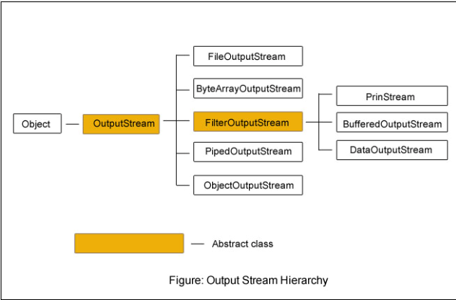
OutputStream : Hierarchy

Slide 56
Input Stream : Class
InputStream class
Abstract class.
Super class of all classes representing an input stream of bytes.
Useful methods of InputStream
public abstract int read()throws IOException
public int available()throws IOException
public void close()throws IOExceptionis

Slide 57
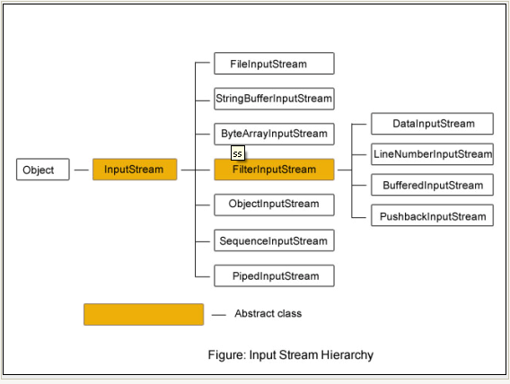
Input Stream : Hierarchy

Slide 58
FileOutputStream
FileInputStream

Slide 59
BufferedOutputStream
Used for buffering an output stream.
Internally uses buffer to store data.
Adds more efficiency than to write data directly into a stream.
Makes the performance fast.
For adding the buffer in an OutputStream, use the BufferedOutputStream class. Let's see the syntax for adding the buffer in an OutputStream:
OutputStream os= new BufferedOutputStream(new FileOutputStream(“path"));
Code example

Slide 60
BufferedInputStream
Used to read information from stream.
Internally uses buffer mechanism to make the performance fast.
When the bytes from the stream are skipped or read, the internal buffer automatically refilled from the contained input stream, many bytes at a time.
When a BufferedInputStream is created, an internal buffer array is created.
Sample Code example

Slide 61
Java Collection Framework
Collection : Group of elements
Framework :
provides readymade architecture.
represents set of classes and interface.
is optional.
Collection Framework : Framework for working on collections. Collection framework represents a unified architecture for storing and manipulating group of objects. It has: Interfaces and its implementations i.e. classes and Algorithm.

Slide 62
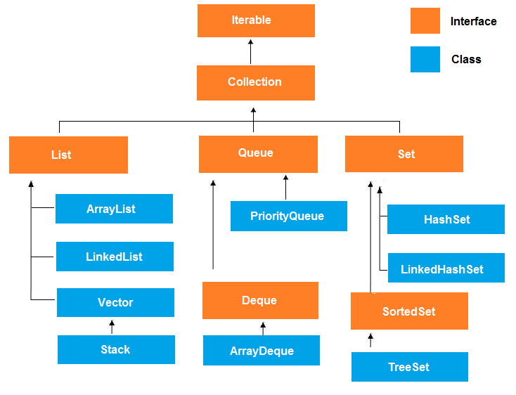
Collection Hierarchy

Slide 63
Collection Interface methods
boolean add(Object obj)
boolean addAll(Collection c)
void clear( )
boolean contains(Object obj)
boolean containsAll(Collection c)
boolean equals(Object obj)

Slide 64
Collection Interface methods
int hashCode( )
boolean isEmpty( )
Iterator iterator( )
boolean remove(Object obj)

Slide 65
Collection Interface methods
boolean removeAll(Collection c)
boolean retainAll(Collection c)
int size( )
Object[ ] toArray( )
Object[ ] toArray(Object array[ ])

